Slide 1
Unsupervised Curricula for Visual Meta-Reinforcement Learning
Allan Jabri, Kyle Hsu, Ben Eysenbach, Abhishek Gupta, Sergey Levine, Chelsea Finn
NeurIPS 2019

Slide 2
The Need to Generalize
C elegans
(the environment is dynamic / changing)
Left: show c elegans doing infotaxis
Right: show new Caledonian crow using tools (generalizing)

Slide 3
From Specialists to Generalists
Visuals showing one of each
Notes:
We want to efficiently build systems that generalize
Transfer of function
Requirement of less direct supervision
Multi-task learning
Meta-learning
Continual learning
Unsupervised learning
…

Slide 4
Goal: Prepare a visuomotor agent with transferrable RL strategies by first learning self-generated tasks.

Slide 5
Generalization and Transfer
We want to efficiently build systems that generalize
Transfer of function
Requirement of less direct supervision
Multi-task learning
Meta-learning
Continual learning
Unsupervised learning
…

Slide 6
Multi-task Reinforcement Learning
Contextual Policies
Condition policy on
given task description
e.g. a goal
Meta-learning for RL
Condition policy on
description of task inferred
from data collected by policy
more general

Slide 7
Meta-Reinforcement-Learning
Task Inference
Condition policy on
description of task inferred
from data collected by policy
learn to explore,
to best exploit
learn to associate stimulus and reward
[pixel example of stimulus and reward]

Slide 8
Meta-Reinforcement-Learning
Condition policy on
description of task inferred
from data collected by policy
Recurrent policy learns to infer task by collecting the right data
Notes:
Note: See each task multiple times, consecutively

Slide 9
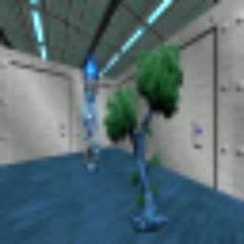
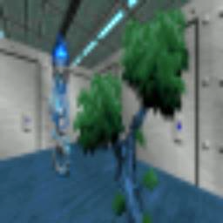
With pixel observations
The meta-learner learns to search for and associate
stimulus and reward.

Slide 10
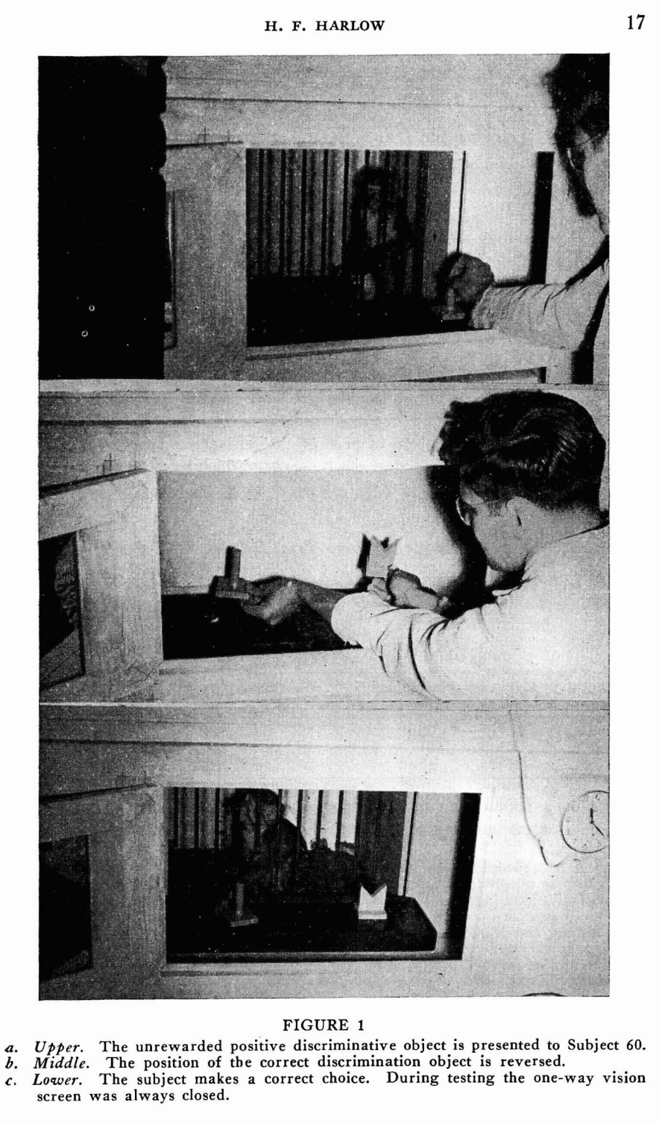
Meta-RL from Pixels
The formation of learning sets. 1949

Slide 11
The Task Distribution
Meta-training tasks determine acquired
task inference and execution strategies
Notes:
–> extent of potential transfer
–> tedious to enumerate, tricky to design

Slide 12
Can we learn useful meta-RL strategies with tasks formed without supervision?

Slide 13
Unsupervised Pre-training
learned model providing
reward functions for meta-learning
i.e. derive a task distribution from a model of data from environment

Slide 14
Transfer
Unsupervised Pre-training
Transfer to Test Tasks

Slide 15
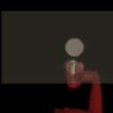
Tasks
Task Acquisition
Unsupervised discovery of tasks
Meta-learning
Learn to learn to solve tasks
Notes:
Goal: Prepare a visuomotor agent with useful RL strategies by pre-training with self-generated tasks.
Prior work: Treat separately, from ground-truth low-dim state
CHALLENGE: JOINT OPTIMIZATION

Slide 16
Tasks
Task Acquisition
Unsupervised discovery of tasks
Meta-learning
Learn to learn to solve tasks
Data?
Notes:
Goal: Prepare a visuomotor agent with useful RL strategies by pre-training with self-generated tasks.
Prior work: Treat separately, from ground-truth low-dim state
CHALLENGE: JOINT OPTIMIZATION

Slide 17
Tasks
Task Acquisition
Unsupervised discovery of tasks
Meta-learning
Learn to learn to solve tasks
Data?
Task distribution should adapt
Notes:
Goal: Prepare a visuomotor agent with useful RL strategies by pre-training with self-generated tasks.
Prior work: Treat separately, from ground-truth low-dim state
CHALLENGE: JOINT OPTIMIZATION

Slide 18
A “useful” task distribution
Diversity
Structure
Notes:
The point is to prepare for generalization

Slide 19
Formulation

Slide 20
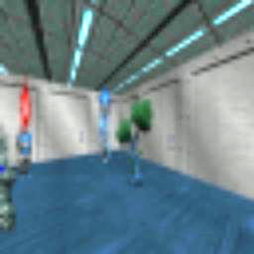
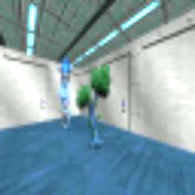
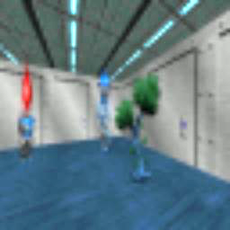
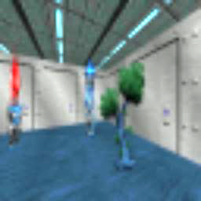
Data
+
1. Organize
2. Meta-Train
+
Update task scaffold
+
Update policy
Tasks

Slide 21
Data
+
1. Organize
2. Meta-Train
+
Update task scaffold
+
Update policy
Tasks
E-step
M-step

Slide 22
Task Acquisition (E-step)
Trajectory-level discriminative clustering

Slide 23
Task Acquisition (E-step)
Trajectory-level discriminative clustering
Conditional independence assumption

Slide 24
Meta-train (M-step)
Policy learns updated task distribution
+
i.e.
+
+

Slide 25
Meta-train (M-step)
Policy learns updated task distribution
+
i.e.
+
+
Density-based Exploration

Slide 26
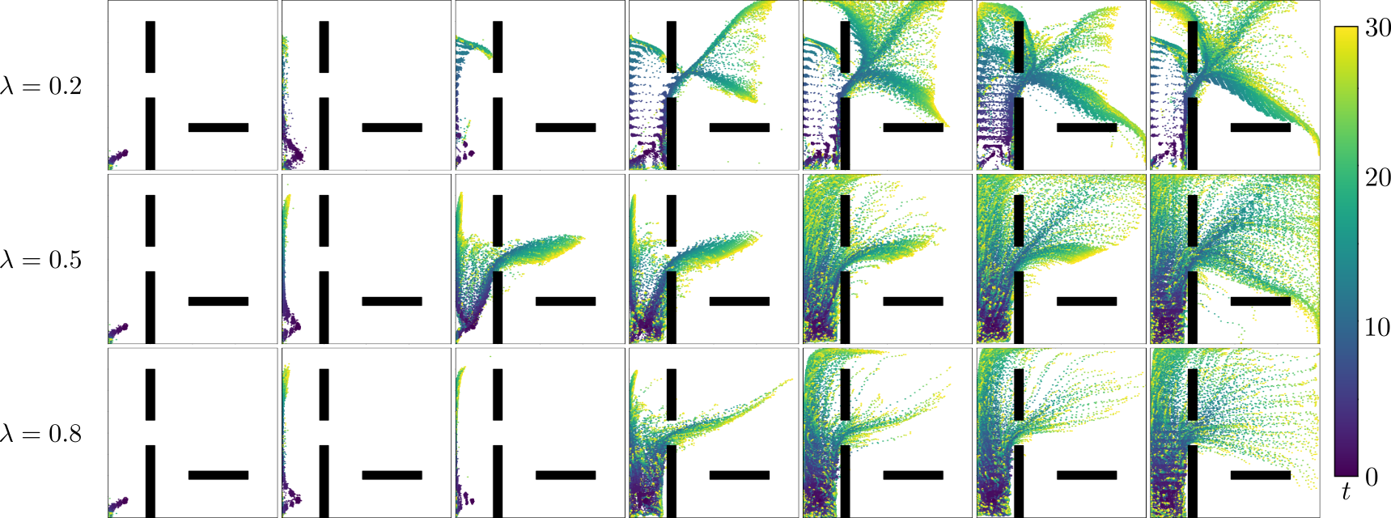
Effect of
Structure v. Diversity

Slide 27
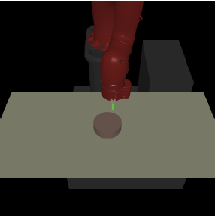
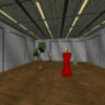
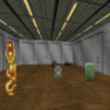
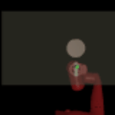
Experimental Setting
Visual Navigation
in VizDoom
Object Pushing
with Sawyer in MuJoCo

Slide 28
What kind of tasks are discovered?

Slide 29
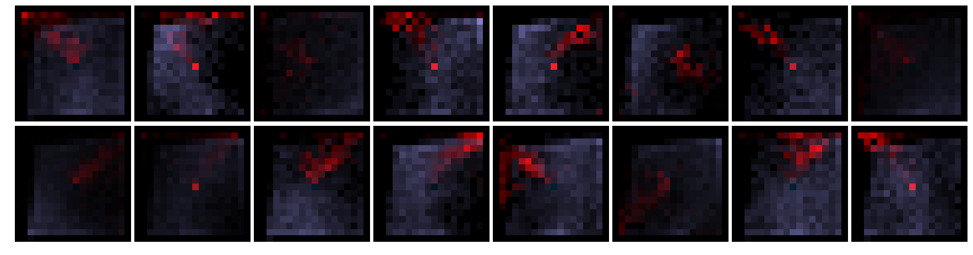
What kind of tasks are discovered?

Slide 30
Transfer to Test Tasks – VizDoom
Notes:
Do these tasks allow for meta-training of strategies that transfer to test tasks?

Slide 31
Transfer to Test Tasks – Sawyer
Notes:
Do these tasks allow for meta-training of strategies that transfer to test tasks?

Slide 32
Faster finetuning
Notes:
Do these tasks allow for meta-training of strategies that transfer to test tasks?

Slide 33
Variants
Notes:
We also compare to variants of our method, that use different task acquisition procedures.

Slide 34
Faster meta-learning

Slide 35
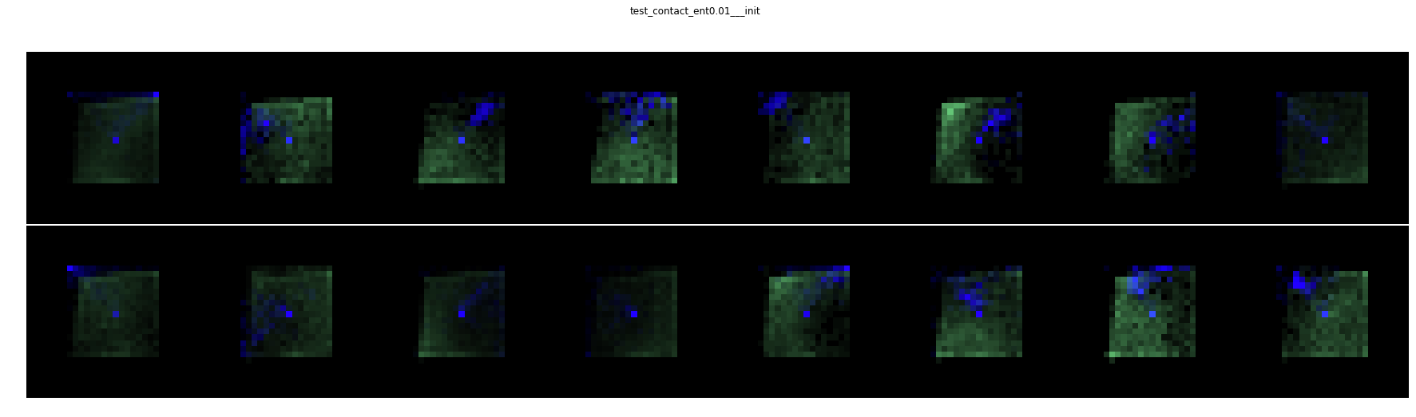
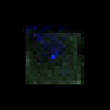
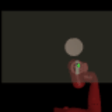


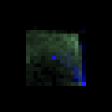
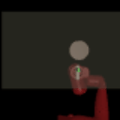
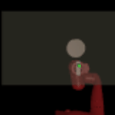
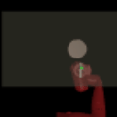
Cluster 12
Cluster 3

Slide 36
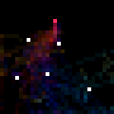
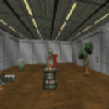
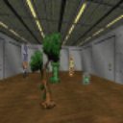
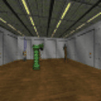
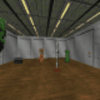
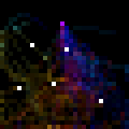
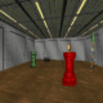
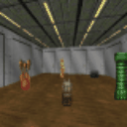
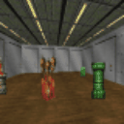
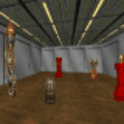

Slide 37
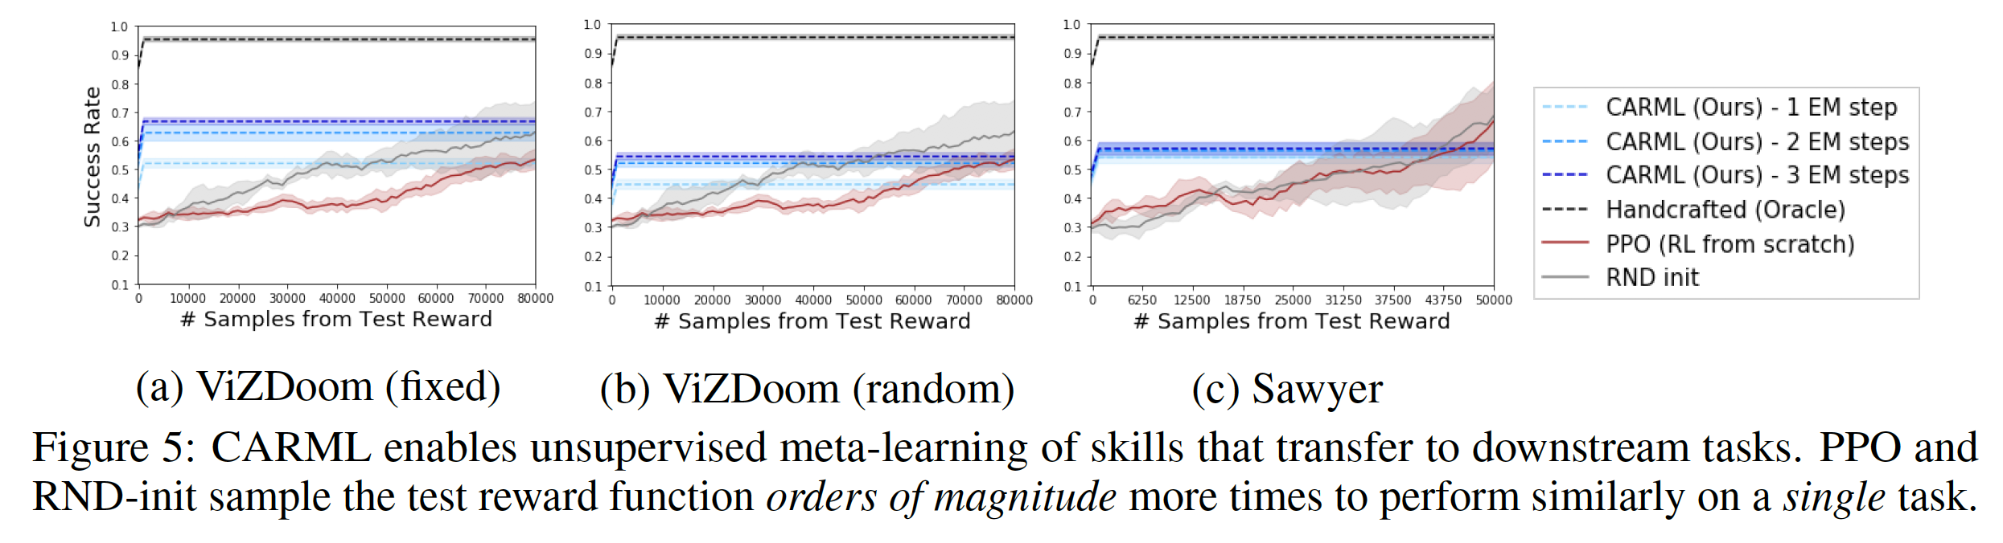
Transfer to Test Task distributions
Apply policy on test object-direct navigation tasks.
Given an environment, randomly sample an object as goal.
Reward function is inverse distance to object.

Slide 38
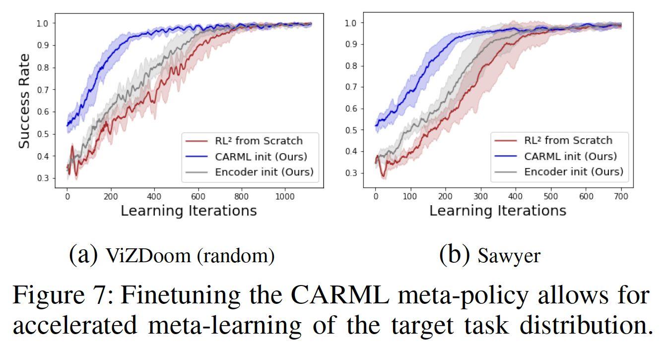
Transfer as Parameter Initialization

Slide 39
Organize
Organization as Information-Maximization
Noisy Channel
Trajectory of states
Z

Slide 40
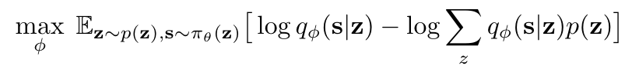
Organize
Organization as Information-Maximization
Fit a deep mixture model to trajectories of current behavior
EM for jointly learning visual representation and trajectory-level clustering
Assume states to be conditionally independent given skill (why?)

Slide 41
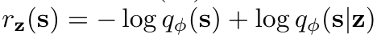
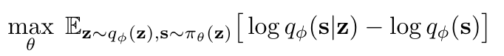
Practice
Construct reward functions from our mixture model
Train policy on task distribution
Notes:
Train our policy to reproduce behavior that we’ve seen in the past
From transient behavior to operationalizable skills

Slide 42
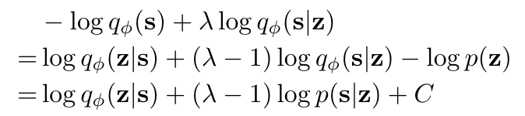
Explore
+
+
Since we have density, we can augment reward function with exploration bonus
+

